Slide 1
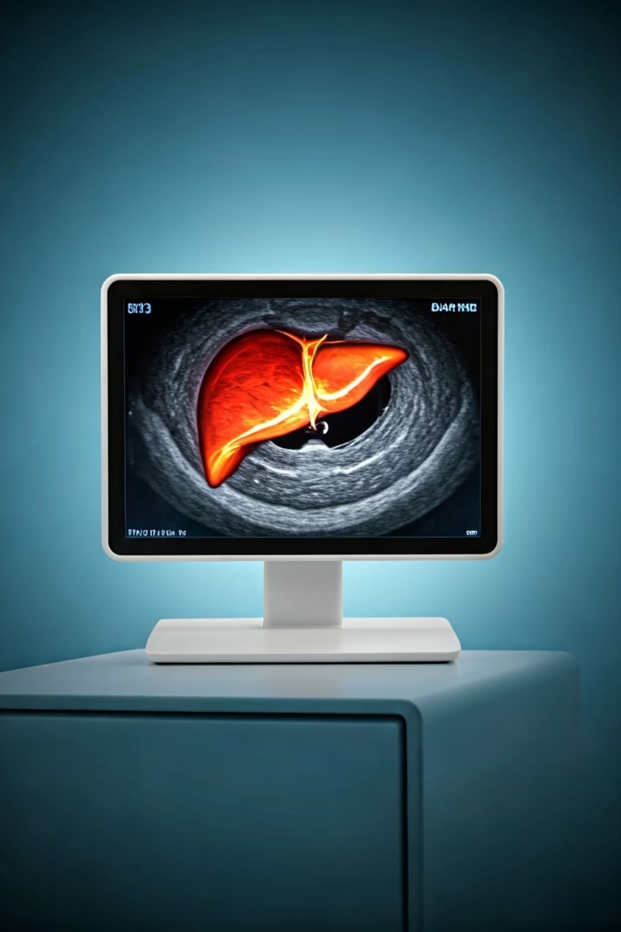

FibroScan / Elastography – Explained for Beginners
What is FibroScan?
FibroScan (also called Elastography) is a special scan used to check the health of your liver. It is quick, safe, and does not hurt.
by Ram N Java

Slide 2
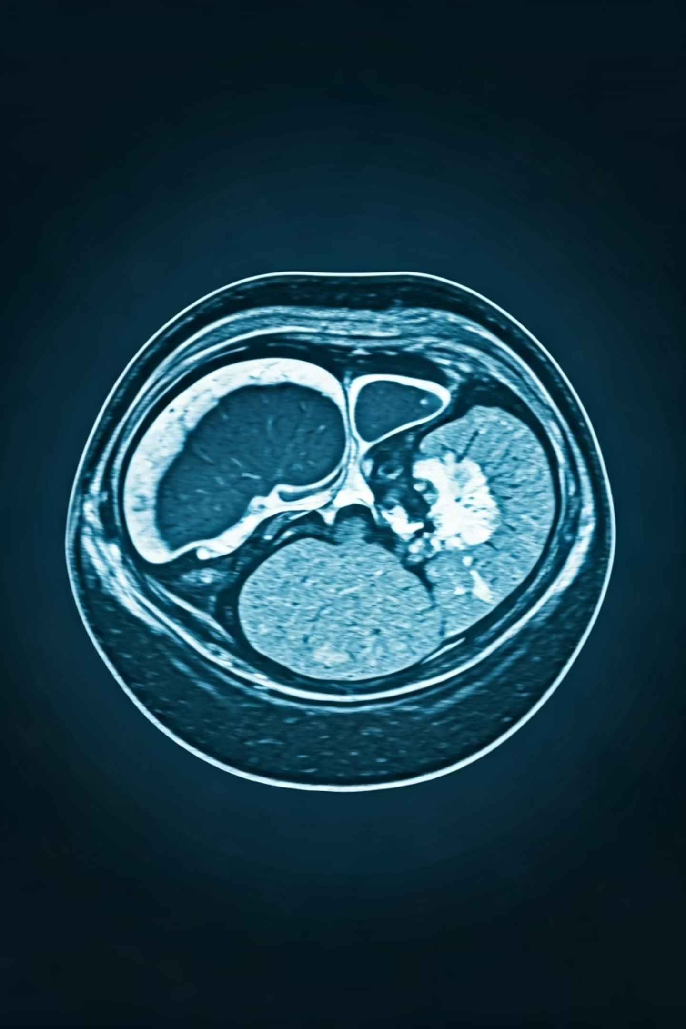
Why is FibroScan done?
Doctors use FibroScan to:
Check if the liver is stiff or damaged
Find out if there is fatty liver, fibrosis, or cirrhosis
Avoid the need for a liver biopsy (a more painful test)

Slide 3
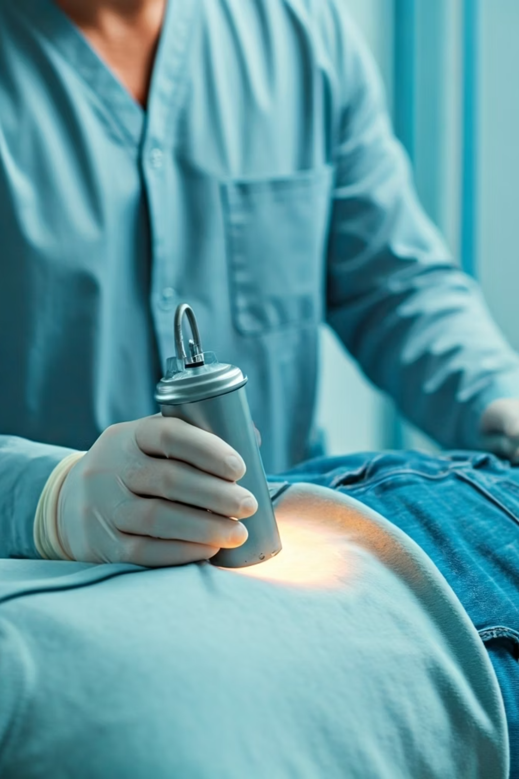




How Does It Work?
Patient Position
You lie down on a bed.
Probe Placement
A nurse or technician puts a small device (like an ultrasound probe) on your right side (near your liver).
Wave Transmission
It sends a small vibration or sound wave into your liver.
Measurement
The machine measures how fast the wave moves.
Understanding Results
If it moves slowly, your liver is soft and healthy.
If it moves quickly, your liver may be stiff or damaged.
Stiff liver = more damage, Soft liver = healthy
The test takes about 5 to 10 minutes.

Slide 4
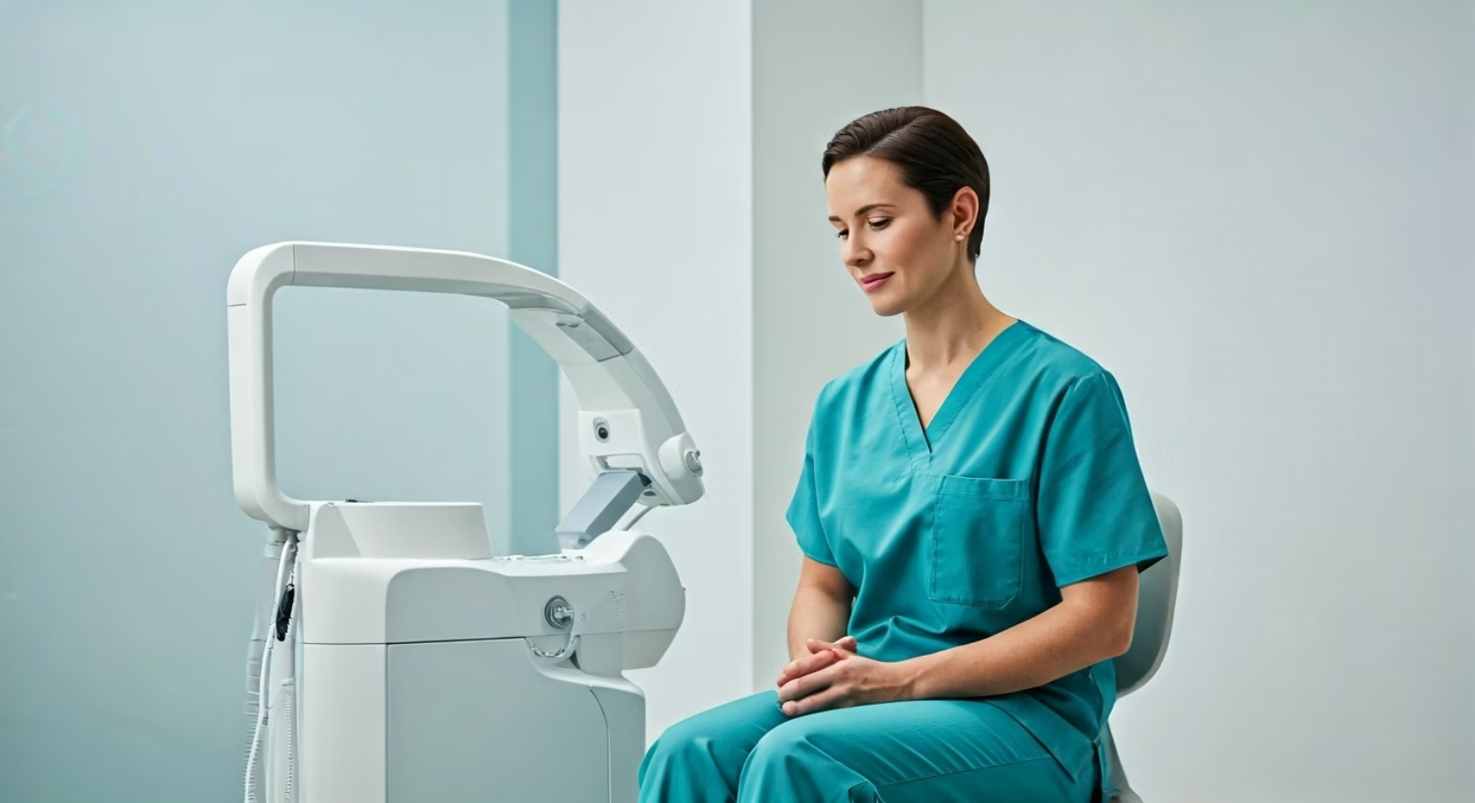
Is it painful?
No. It feels like a small tap on your skin. No needles, no pain, and no cuts.
Do I need to prepare?
Yes, don't eat or drink anything for 2 to 3 hours before the test. Tell your doctor about any health problems or medicines you take.

Slide 5
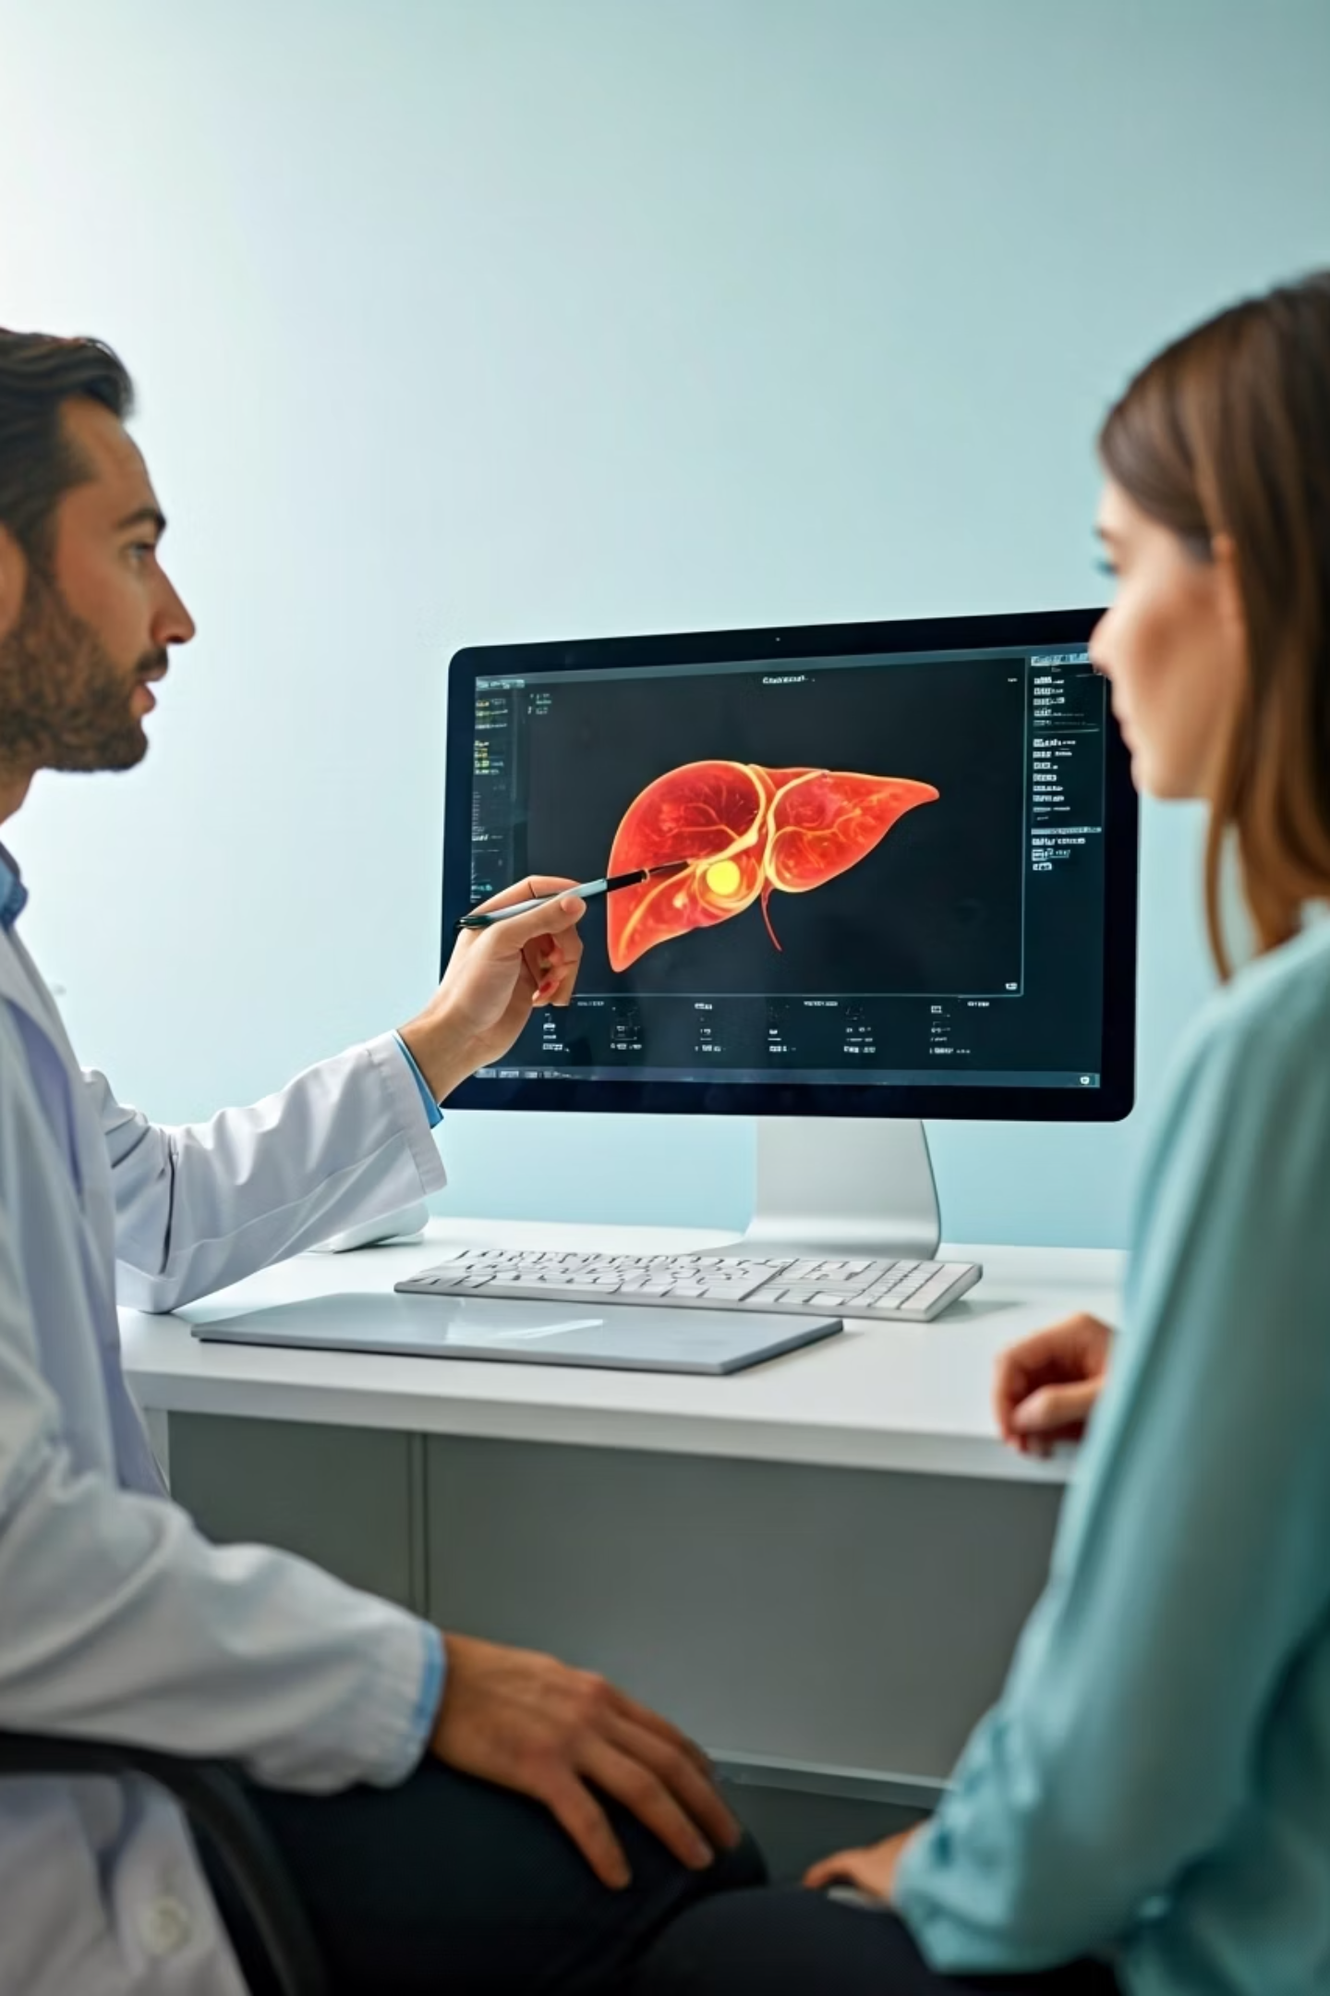



What do the results mean?
Low stiffness
Healthy or mild liver issue
Medium stiffness
Some liver damage
High stiffness
Severe liver damage or cirrhosis
The doctor will explain your score and what it means for your health.

Slide 6
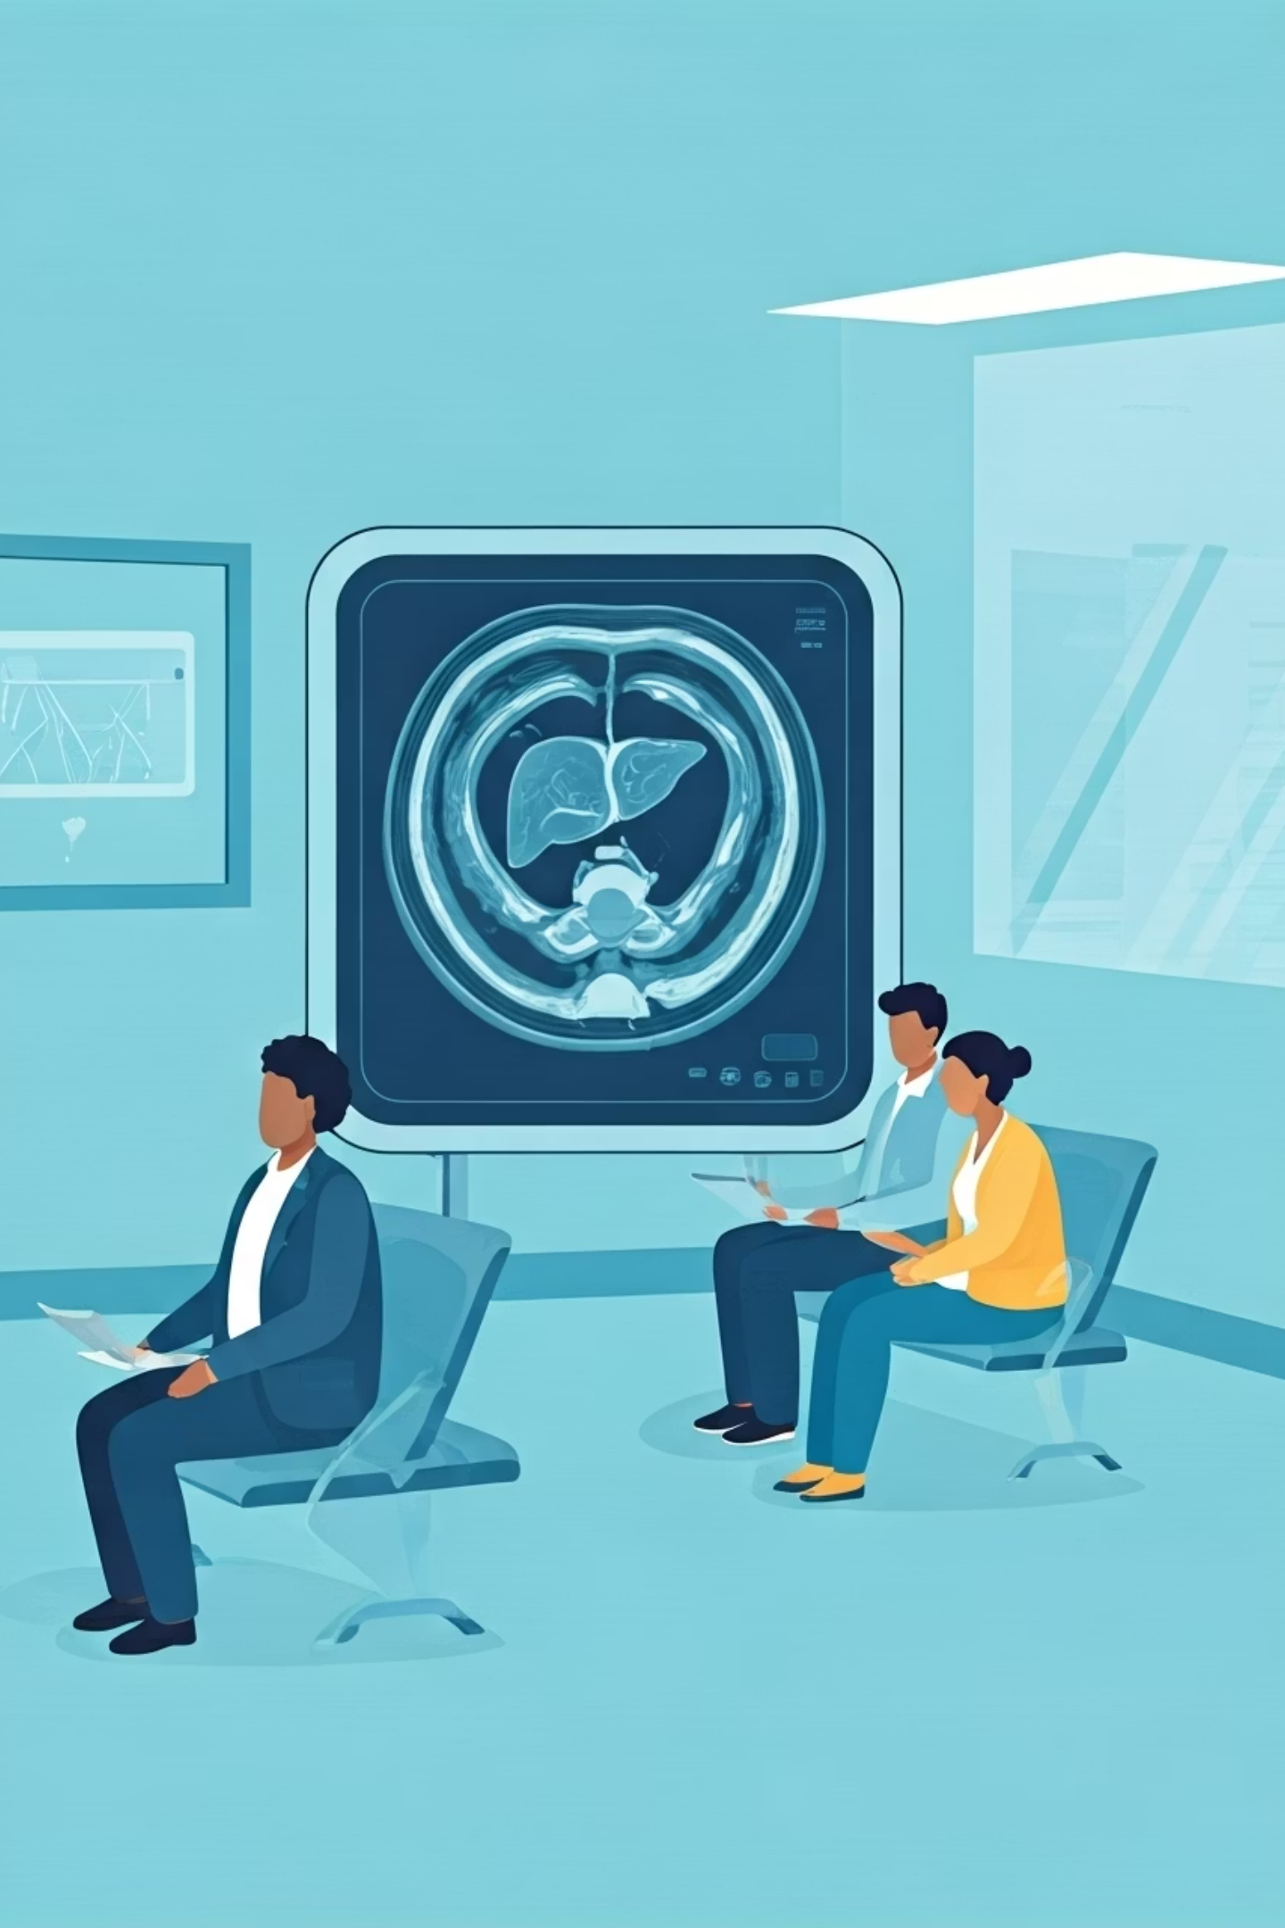




Who needs a FibroScan?
People with fatty liver
Patients diagnosed with fatty liver disease benefit from regular monitoring.
People with Hepatitis B or C
Viral hepatitis patients need assessment of liver damage progression.
People who drink alcohol heavily
Those with history of heavy alcohol consumption require liver health evaluation.
People with diabetes or obesity
Metabolic conditions can impact liver health and require monitoring.

Slide 7

Benefits of FibroScan
Fast
The procedure typically takes only 5-10 minutes to complete.
Painless
Patients experience no discomfort during the scan.
No side effects
The procedure is completely non-invasive with no recovery needed.
More comfortable than biopsy
Provides valuable information without the risks of invasive procedures.

